Slide 1
Evalink
Sistema de Evaluación de Desempeño Compromiso de Avance – 03 de octubre 2025
Equipo:
Vicente Farías
Sharay Muñoz
Sebasthian Silva

Slide 2
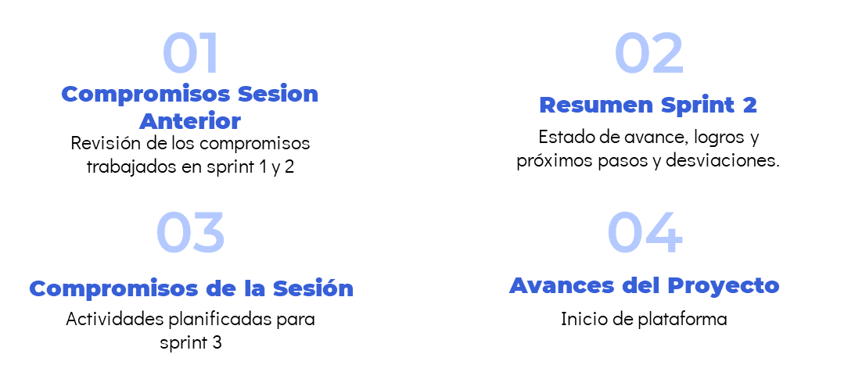
Agenda

Slide 3
Compromisos Sesión
ID | Actividad / Historia | Responsable | Sprint | Estado | Comentarios
28 | Gestión de Usuarios | VF | Sprint 1 | Finalizado | Esta HU quedó atrasada del sprint 1
34 | MER de Plantillas | SM | Sprint 2 | En progreso | Modelo Entidad Relación
35 | Diseño de configuración de módulos iniciales según rol de usuario | SS | Sprint 2 | En progreso | Diseños en Figma
31 | Mantener sesión activa | VF | Sprint 2 | En progreso (QA) | Guardar Cookies
27 | Diseño de plantilla de Evaluación | SS | Sprint 2 | Por Hacer | Diseño en Figma
36 | Construcción de pantallas iniciales basadas en diseño de rol | VF | Sprint 2 | Por Hacer | Desarrollo de lo diseñado
8 | Requerimientos no funcionales - Documentación | SM | Sprint 2 | Por Hacer | Finalizar documento de requerimientos de software

Slide 4
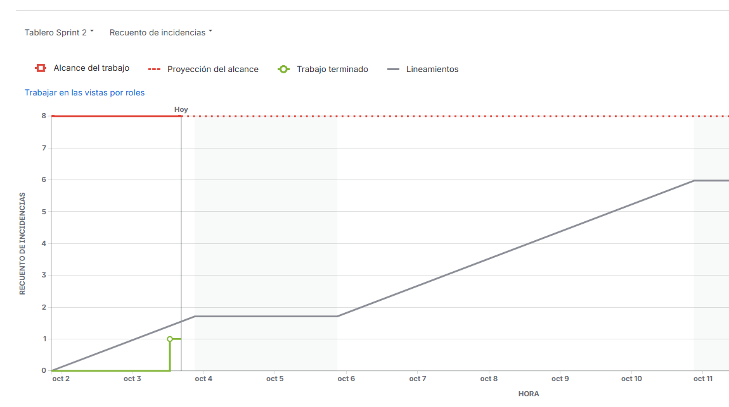
Resumen Sprint 2
Fecha Reporte |  |  | Explicación del Desvío
03/10 |  |  | El tiempo de QA no se estimó correctamente.
Fecha inicio
01/10
Fecha Fin
15/10 |  |  | Próximos Hitos Claves
Estado Actual |  |  | Finalización Sprint 2: 15/10 Planificación Sprint 3: 16/10
Cerrado: 10%
En curso: 45%
Sin Iniciar: 45%
Estado del Sprint: En Curso
Estado anterior (Sprint 1) | Temas Destacados |  | Temas Abierto
Avance Real: 97% | Logros Gestión de usuarios en Django Admin Inicio de MER para las plantillas | Próximos pasos Iniciar el diseño de módulos que le dará la bienvenida a cada usuario Iniciar la implementación de bienvenida tras el inicio de sesión
Avance Planificado: 100%
Desviación: 3%
Estado: Cerrado (Completado)

Slide 5
Próximos Compromisos de Sesión
ID | Actividad / Historia | Responsable | Sprint | Estado | Comentarios
33 | Asignar Autoevaluación | Equipo | Sprint 3 | Tareas por hacer | Asignación masiva de autoevaluación en base a plantilla, periodo y usuario
15 | Autoevaluación para docentes | Equipo | Sprint 3 | Tareas por hacer | Formulario para realizar la autoevaluación
13 | Historial de Plantillas | Equipo | Sprint 3 | Tareas por hacer | Reutilizar estructuras de plantillas
19 | Implementar Generación y validación de JWT | Equipo | Sprint 3 | Tareas por hacer | Garantizar seguridad en cada api con JWT

Slide 6
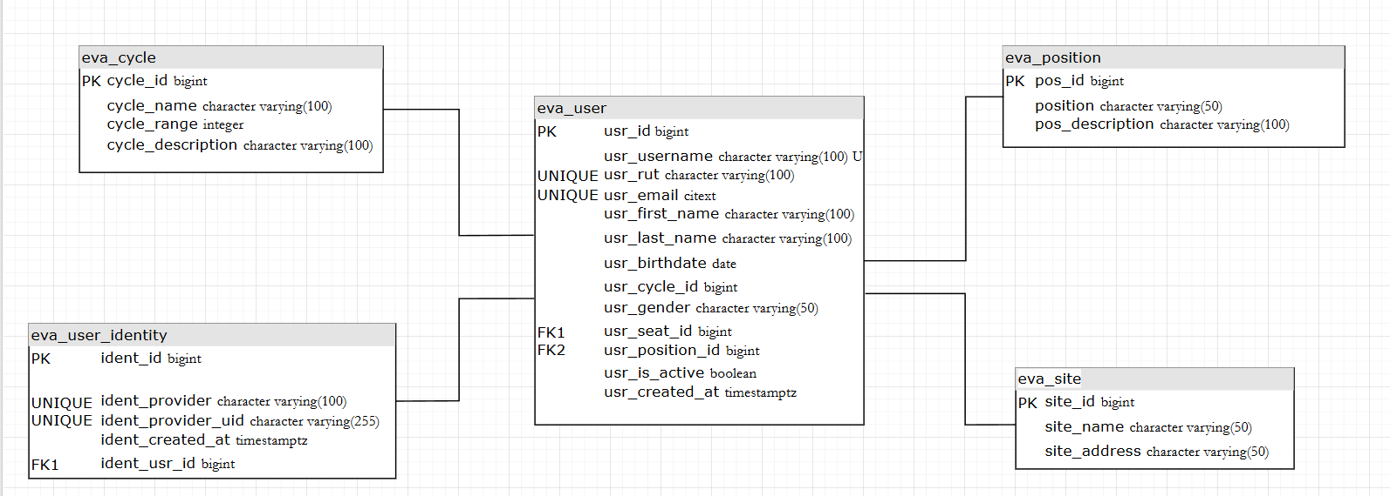
Avances – MER Usuarios Evalink

Slide 7
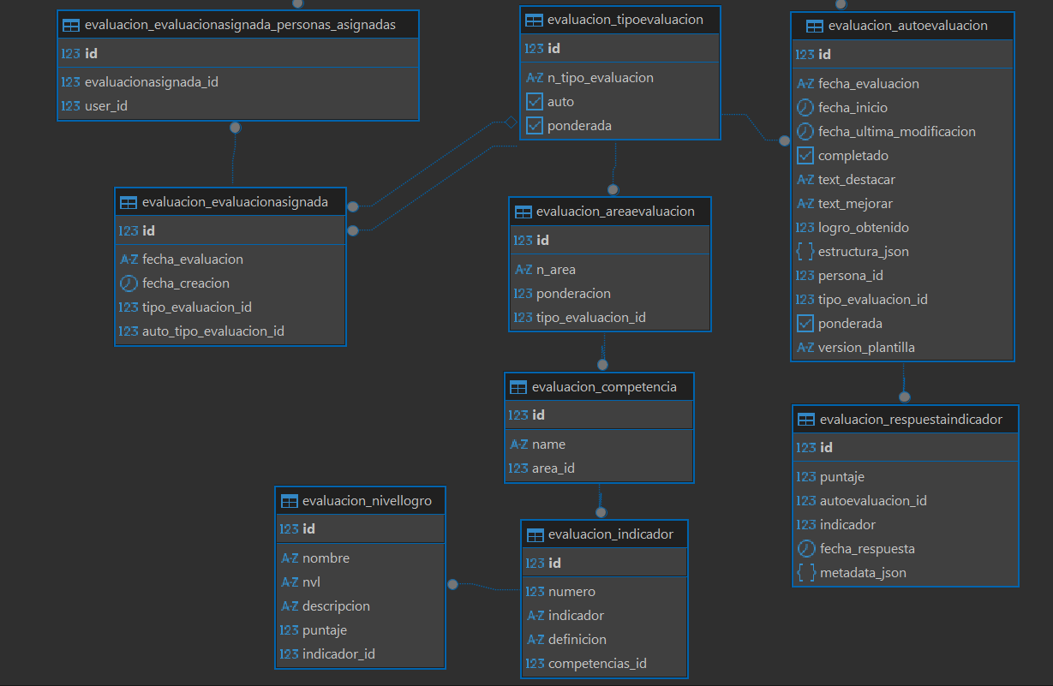
Avances – MER Autoevaluación Evalink

Slide 8

Inicio de la plataforma

Slide 9
Muchas Gracias!

Slide 10

A picture is worth a thousand words

Slide 11
Our history
19XX
19XX
2XXX
Today
Earth is the only one that harbors life in the Solar System
Despite being red, Mars is actually a very cold place
Jupiter is the biggest planet in the entire Solar System
Saturn is a gas giant and has several rings around itself

Slide 12
What sets us apart?
Neptune
The Sun
Pluto
Neptune is the farthest planet from the Sun
The Sun is the star at the center of the Solar System
Pluto is now considered a dwarf planet

Slide 13
Guiding principles
Mission
Vision
Mercury is the smallest one in the Solar System
Venus is the second planet from the Sun

Slide 14
- Someone Famous
“This is a quote, words full of wisdom that someone important said and can make the reader get inspired.”

Slide 15
02
Market analysis
You can enter a subtitle here if you need it

Slide 16
Audience demographics
Age
Interests
15-25: 35%
26-35: 65%
Gender
Mercury is the closest planet to the Sun and the smallest one in the Solar System
Female 56%
Male
30%
Other
14%
Reading 40%
Cooking 10%
Movies
20%
Music 30%

Slide 17
Top social networking sites
15%
35%
50%
Instagram
YouTube
TikTok

Slide 18
Buyer persona
Mailing she usually receives
Helena Smith
Mercury
Venus
Earth
Mars
Age: 25
Gender: female
Studies: Advertising
Location: Puerto Rico
Job: Publicist
Income range: $2000
Marital status: married
Hobbies: board games
Most recent interests
Jupiter
Saturn
Neptune
Pluto

Slide 19
Analyzing the competition
 | Logo | Name | Likes | Posts | Followers | Engagement
1 |  | Company 1 | 2.5M | 300 | 950K | 75%
2 |  | Company 2 | 6.3M | 590 | 686K | 50%
3 |  | Company 3 | 5.6M | 130 | 523K | 25%
4 |  | Company 4 | 6.8M | 690 | 210K | 15%
5 |  | Company 5 | 1.4M | 780 | 53K | 05%

Slide 20
03
Goals & strategy
You can enter a subtitle here if you need it

Slide 21
Our goals
Goal #1
Goal #2
Goal #3
Goal #4
Goal #5
Goal #6
Mercury is the closest planet to the Sun
Venus is the second planet from the Sun
Earth is the third planet from the Sun
Despite being red, Mars is actually a cold place
Jupiter is the biggest planet in the System
Saturn is a gas giant and has several rings

Slide 22
Our strategy
Mother brand
The Sun is the star at the center of the Solar System
Media A
Media B
Media C
Jupiter is the biggest planet in the System
Saturn is a gas giant and has several rings
Neptune is actually a far away planet
Outcome A
Outcome B
The Sun is the star at the center of all
The Moon is Earth’s only natural satellite

Slide 23
Awesome words

Slide 24
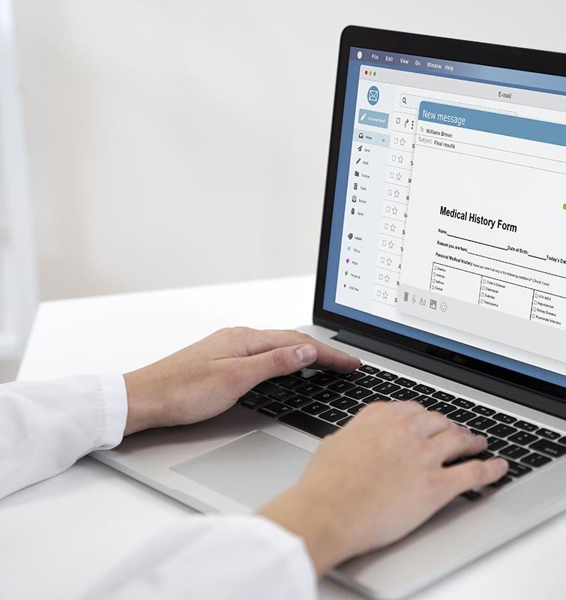
A picture reinforces the concept
Images reveal large amounts of data, so remember: use an image instead of a long text. Your audience will appreciate it

Slide 25
04
Content plan
You can enter a subtitle here if you need it

Slide 26
Our areas of expertise
Area A
Promote social media
Mercury is the closest planet to the Sun and the smallest one in the Solar System
Area B
Public awareness
Venus has a beautiful name and is the second planet from the Sun
Area C
Encourage donation
Earth is the only one that harbors life in the Solar System

Slide 27
What content are we going to create?
Mars
Jupiter
Saturn
Neptune
Despite being red, Mars is actually a cold place
Jupiter is a gas giant and the biggest planet in the System
Saturn is a gas giant and has several rings
Neptune is the farthest planet from the Sun

Slide 28
What content are we going to use?
Do you know what helps you make your point clear?
Lists like this one:
They’re simple
You can organize your ideas clearly
You’ll never forget to buy milk!
And the most important thing: the audience won’t miss the point of your presentation

Slide 29
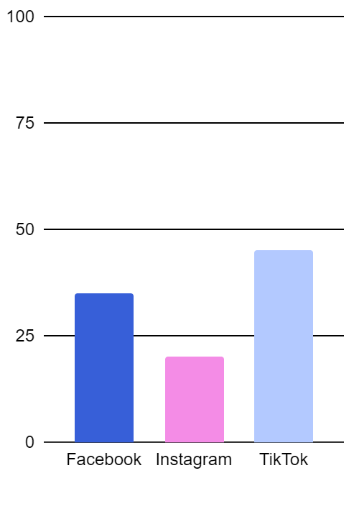
What platforms are we going to use?
 | Facebook | Instagram | TikTok
Goal | Write your text in here | Write your text in here | Write your text in here
Objectives | Write your text in here | Write your text in here | Write your text in here
Audiences | Write your text in here | Write your text in here | Write your text in here
Measurement | Write your text in here | Write your text in here | Write your text in here
Follow the link in the graph to modify its data and then paste the new one here. For more info, click here

Slide 30
Content sharing plan
Social network | Content | Day | Time
Facebook | Mercury | Monday | 10:30 AM
Instagram | Venus | Saturday | 12:30 PM
TikTok | Earth | Sunday | 10:40 PM
LinkedIn | Mars | Everyday | 05:25 PM
YouTube | Jupiter | Friday | 03:35 PM

Slide 31
Calendar
Sun | Mon | Tue | Wed | Thu | Fri | Sat
 |  | 1 | 2 | 3 | 4 | 5
6 | 7 | 8 | 9 | 10 | 11 | 12
13 | 14 | 15 | 16 | 17 | 18 | 19
20 | 21 | 22 | 23 | 24 | 25 | 26
27 | 28 | 29 | 30 | 31
IG: Post #1
IG: Post #2
TikTok: Post #1
FB: Post #1
TikTok: Post #2
FB: Post #2
TikTok: Post #3
FB: Post #3
TikTok: Post #4

Slide 32
05
Budget
You can enter a subtitle here if you need it

Slide 33
Our budget
$100k
$25K
$250k
$500
For TikTok
For Instagram
For Facebook
For Linkedin

Slide 34
150,000
Big numbers catch your audience’s attention

Slide 35


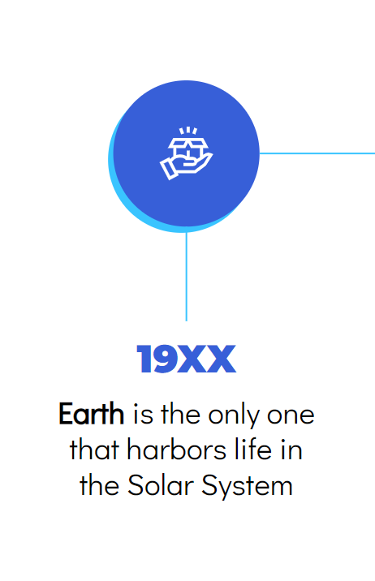
Mockup devices
You can replace the image on the screen with your own work. Just right-click on it and select “Replace image”

Slide 36
06
KPI overview
You can enter a subtitle here if you need it

Slide 37
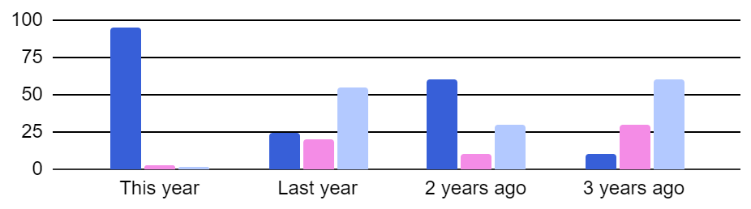
KPI overview
Social media engagement
Followers: 5,408
Followers: 1,208
Views & likes: 408
Connect: 400
Followers: 5,000
Product A
Product B
Product C
Follow the link in the graph to modify its data and then paste the new one here. For more info, click here

Slide 38
Where will we communicate?
America
Neptune is the farthest planet from the Sun
Asia
The Sun is the star at the center of all

Slide 39
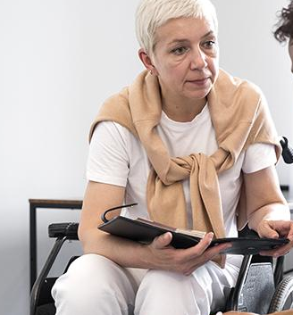

Our team
Sage Alvarado
Ganesh Fujin
You can speak a bit about this person here
You can speak a bit about this person here

Slide 40
Thanks!
Does anyone have any questions?
addyouremail@freepik.com
+91 620 421 838
yourcompany.com
Please keep this slide as attribution

Slide 41
Icon pack

Slide 42
Alternative resources
Here’s an assortment of alternative resources whose style fits the one of this template:
Modern web banners with flat design

Slide 43
Resources
Did you like the resources of this template? Get them for free at our other websites! Photos:
Crop man using computer keyboard
Doctor writing about routine medical checkup
Medium shot black man at work
Full shot woman in wheelchair at work
Vectors:
Gradient effect landing page
Modern web banners with flat design
Icons:
Icon Pack: Marketing & SEO | Lineal

Slide 44
Instructions for use
If you have a free account, in order to use this template, you must credit Slidesgo by keeping the Thanks slide. Please refer to the next slide to read the instructions for premium users.
As a Free user, you are allowed to:
Modify this template.
Use it for both personal and commercial projects.
You are not allowed to:
Sublicense, sell or rent any of Slidesgo Content (or a modified version of Slidesgo Content).
Distribute Slidesgo Content unless it has been expressly authorized by Slidesgo.
Include Slidesgo Content in an online or offline database or file.
Offer Slidesgo templates (or modified versions of Slidesgo templates) for download.
Acquire the copyright of Slidesgo Content.
For more information about editing slides, please read our FAQs or visit our blog:
https://slidesgo.com/faqs and https://slidesgo.com/slidesgo-school

Slide 45
Instructions for use (premium users)
As a Premium user, you can use this template without attributing Slidesgo or keeping the "Thanks" slide.
You are allowed to:
Modify this template.
Use it for both personal and commercial purposes.
Hide or delete the “Thanks” slide and the mention to Slidesgo in the credits.
Share this template in an editable format with people who are not part of your team.
You are not allowed to:
Sublicense, sell or rent this Slidesgo Template (or a modified version of this Slidesgo Template).
Distribute this Slidesgo Template (or a modified version of this Slidesgo Template) or include it in a database or in any other product or service that offers downloadable images, icons or presentations that may be subject to distribution or resale.
Use any of the elements that are part of this Slidesgo Template in an isolated and separated way from this Template.
Register any of the elements that are part of this template as a trademark or logo, or register it as a work in an intellectual property registry or similar.
For more information about editing slides, please read our FAQs or visit our blog:
https://slidesgo.com/faqs and https://slidesgo.com/slidesgo-school

Slide 46
Fonts & colors used
This presentation has been made using the following fonts:
Montserrat
(https://fonts.google.com/specimen/Montserrat)
Didact Gothic
(https://fonts.google.com/specimen/Didact+Gothic)
#000000
#375fd8
#ffffff
#f48ce6
#39c4ff
#b3c9ff

Slide 47





Storyset
Create your Story with our illustrated concepts. Choose the style you like the most, edit its colors, pick the background and layers you want to show and bring them to life with the animator panel! It will boost your presentation. Check out how it works.
Pana
Amico
Bro
Rafiki
Cuate

Slide 48
Use our editable graphic resources...
You can easily resize these resources without losing quality. To change the color, just ungroup the resource and click on the object you want to change. Then, click on the paint bucket and select the color you want. Group the resource again when you’re done. You can also look for more infographics on Slidesgo.

Slide 51
JANUARY
FEBRUARY
MARCH
APRIL
MAY
JUNE
PHASE 1
Task 1
Task 2
PHASE 2
Task 1
Task 2
JANUARY
FEBRUARY
MARCH
APRIL
PHASE 1
Task 1
Task 2

Slide 54
...and our sets of editable icons
You can resize these icons without losing quality.
You can change the stroke and fill color; just select the icon and click on the paint bucket/pen.
In Google Slides, you can also use Flaticon’s extension, allowing you to customize and add even more icons.

Slide 55
Educational Icons
Medical Icons

Slide 56
Business Icons
Teamwork Icons

Slide 57
Help & Support Icons
Avatar Icons

Slide 58
Creative Process Icons
Performing Arts Icons

Slide 59
Nature Icons

Slide 60
SEO & Marketing Icons

Slide 61


